Slide 1

DriverPass System Analysis
[Ugochuku Enyi Ebere]
Notes:
[No speaker notes required for this slide.]

Slide 2

System Requirements
[System should be cloud based
System is compatible with all user platforms
The system requires an active internet connection
System will verify users based on stored information
System will allow users to edit their package.]
Notes:
[I have listed two nonfunctional requirements, which tell us how the system operates, and three functional requirements, which tell us the tasks the system carries out or provides. The non-functional requirements are numbers 1 and 2.
The system should be cloud-based to allow the team (driver pass) to focus less on the maintenance of the system and instead on its business aspects. This will allow the admins to manage the system's packages, deals, and promotional content.
For the second requirement, we want the system to be accessible by anyone, on any device, from any location in the U.S., which is why the system should be compatible with all user devices. The performance of the system might need to be better for older devices.
For the functional requirements.
3. the system requires an active internet connection for a user to access most of the driver pass content and edit their information.
4. To use the system, users must provide their user information, verified using our info on users stored in the database.
5. users can choose or change the package they subscribe to.]

Slide 3
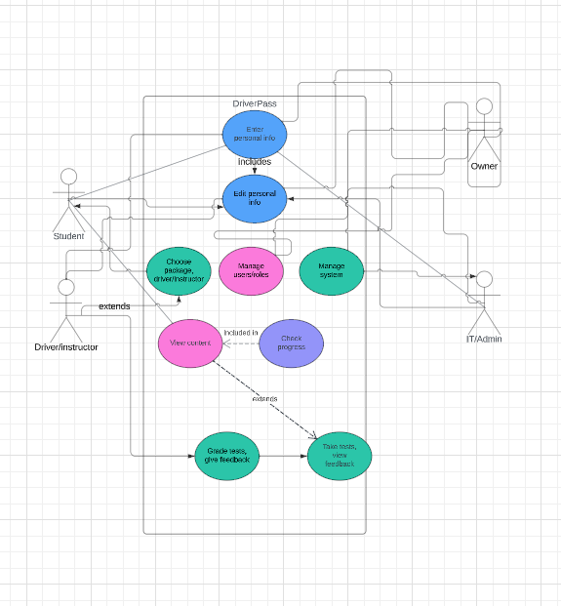
Use Case Diagram
[Insert your use case diagram here.]
Notes:
[The diagram contains four users. They are the owner, IT/Admin, Driver/instructor, and Student. There are nine total actions the users can perform combined. The owner and IT/admin can enter personal info, edit personal information, manage users/roles, and manage the system. The Student can enter personal info, edit personal info, choose package, driver/instructor, view content, take tests, view feedback, and check progress. The driver/instructor can grade tests, give feedback, and enter personal info.]

Slide 4
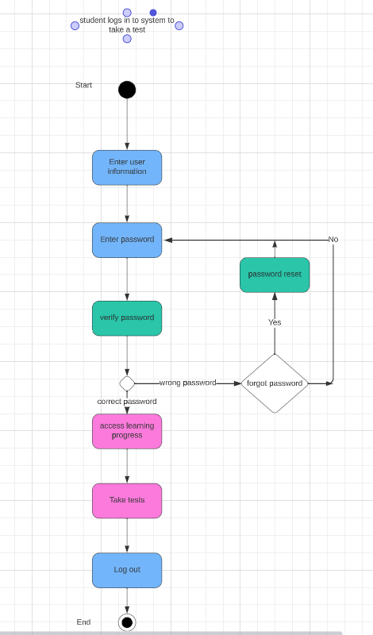
Activity Diagram
[Insert one of your activity diagrams here.]
Notes:
[This diagram shows what will happen when a user logs in to the system to take a test. First, the user enters their information(password, username, etc.), and the password is then sent to the admin for validation. If the password needs to be corrected, the user is asked if they have forgotten it. If yes, they are sent a link to reset their password; if not, they are sent back to the login to reenter it. Upon reentry, they can access their learning progress and content if the password is correct. Through this, they can take a test and log out.]

Slide 5
Security
[Unique usernames and emails
Password and email verification
Security questions and Password reset
Cooldown periods
Two factor authentication.]
Notes:
[There are five simple features we included to bolster security in the system.
Unique username – each account will have a unique username and email. This will ensure that users can only access information for one account tied to that username or email.
Password and email verification – users will provide a password and email tied to their username to log in. If the password or email does not match our provided secure user password, the user cannot log in to the account.
Security questions and password reset – when a user forgets their password, for them to regain access to their account, they will answer a series of security questions that only they know the answers to. If they answer the questions correctly, they can change their password.
Cooldown periods – to prevent brute force hacking or repeated attempts at guessing a user’s password, there will be a cooldown period where the user cannot log in after four failed attempts. The number of allowed attempts will drop by one after every cooldown period.
Two-factor authentication – for an extra layer of security, users can set up a process. The process involves using a random code we send users when they try to log in. The user can log in after they provide the code we sent.]

Slide 6
System Limitations
[Device model/version
Staff limitations
Specialization
Time.]
Notes:
[What are the limitations of your design? In your explanation, keep your audience in mind by avoiding using technical terms.
The system might not be compatible with older versions of specific devices. And even then, it may still cause the system to run slowly if the device is older.
With resources, some of our team members might be overworked, depending on their inclusion in multiple teams, holiday hangovers, etc.
The budget might also not be enough to support the staff and technology working on the project.
Trying to create a system that will function across multiple platforms will require an incredible amount of specialization, time, and people.]

